Slide 1
BUS PASS MANAGEMENT SYSTEM

Slide 2
TABLE STRUCTURE

Slide 5
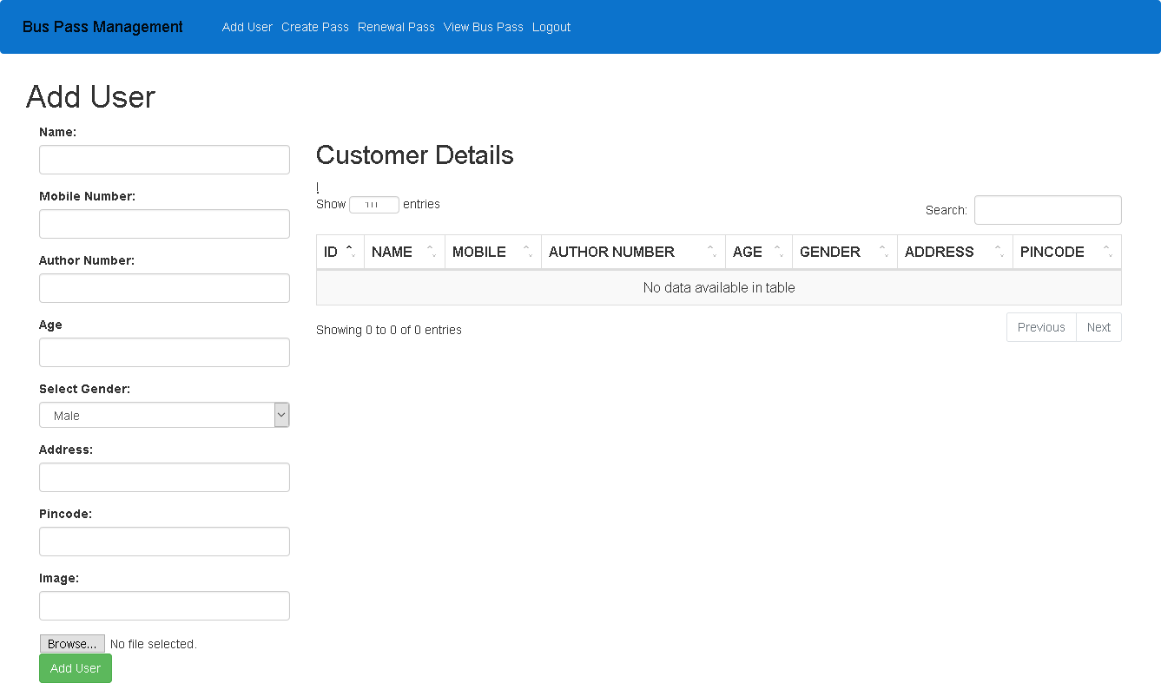

Slide 6
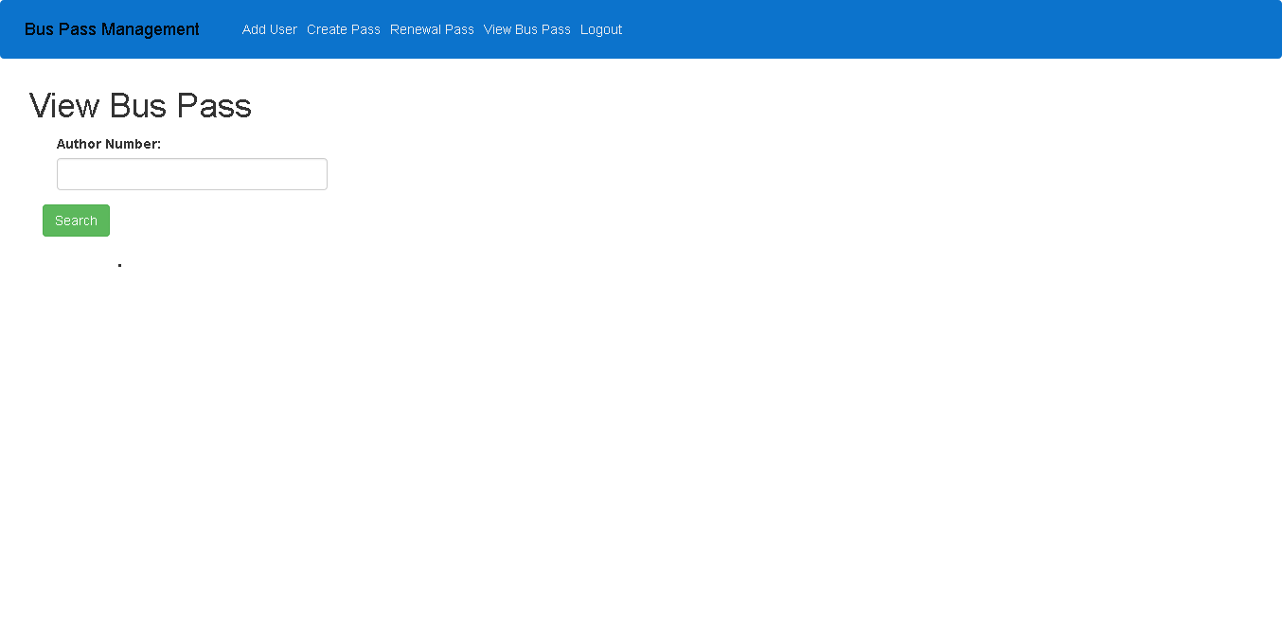

Slide 7
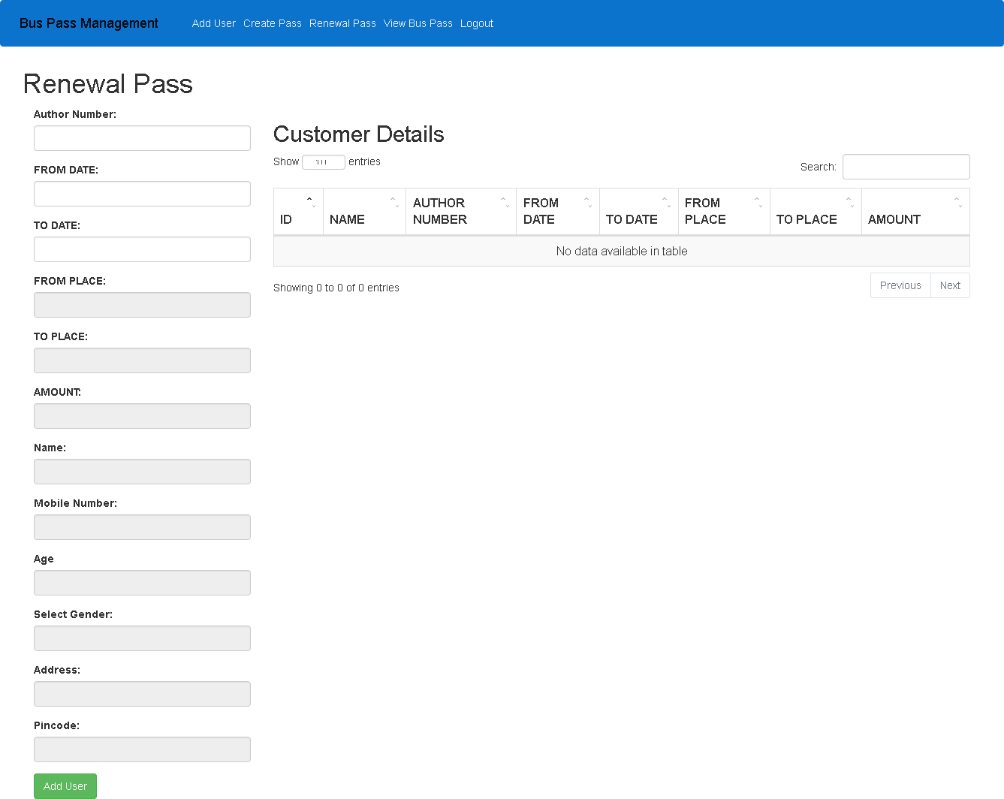

Slide 8
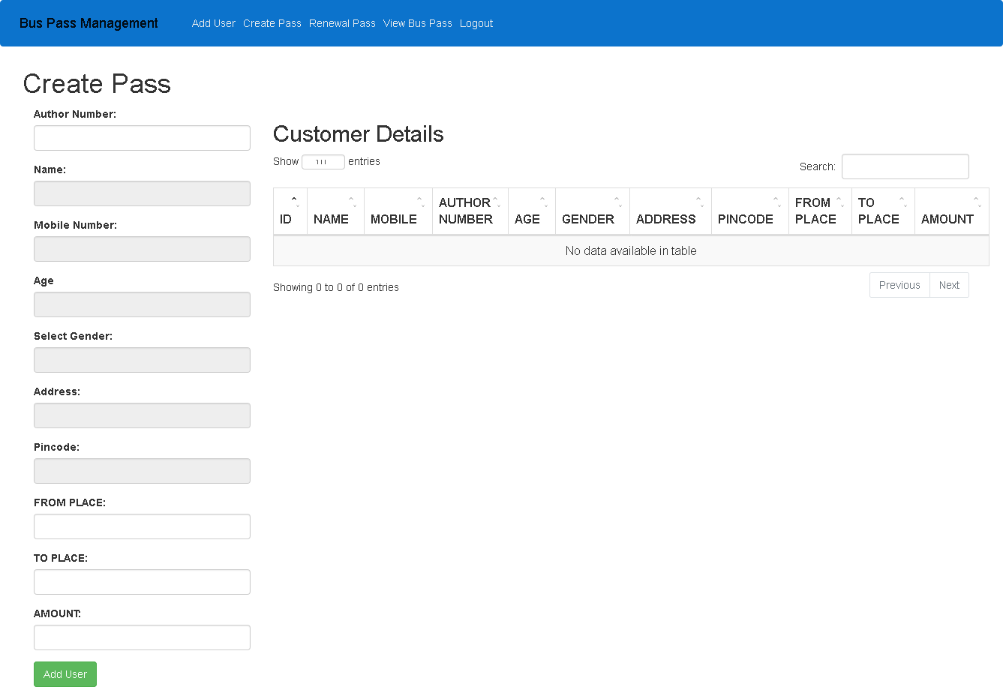

Slide 9
Thank You

